Slide 1

According to Centers for Disease Control and Prevention-https://www.cdc.gov/heartdisease/facts.htm. ”In the united States, someone has a heart attack every 40 seconds. Every year, about 805,000 people in the United States have a heart attack. Of these 605,000 are a first heart attack”.

Slide 2
Heart Diseases are diseases that affects the heart or blood vessels. The risk of certain heart diseases may be increased by smoking, high blood pressure, high cholesterol, unhealthy diet, lack of exercise, and obesity. There are many diseases associated with heart but very few are known to non-medical personal. Most heart diseases can lead to chest pain. The diagnosis of heart disease is done on a combination of clinical signs and test results. The types of tests run will be chosen on the basis of what the physician thinks In this analysis, the types of chest pain one can suffer from relating to the heart diseases under survey are used as our target variable.
INTRODUCTION

Slide 3
A Classification Decision Tree Model on Heart Diseases Analysis
14th December, 2022
Lilian Nwafor Data Analyst

Slide 4
Analytical Process
Data Collection: The data was collected from kaggle: https://www.kaggle.com/datasets/redwankarimsony/heart-disease-data Tools Used: R Programming Language with party, rpart, rpart.plot, readr, dplyr libraries. Data Cleaning and Wrangling: The datasets contained 920 rows and 16 columns Rows with missing values removed 2 duplicate cells removed ID column removed Columns renamed for clarity purpose Finally analyzed 303 columns and 15 rows Changed logical variable to numeric

Slide 5
Exploratory Data Analysis
The youngest age under review is 28 years while the oldest is 77 years. The total number of female is 194 while male 726 There are 4 locations(Cleveland, Hungary, Switzerland,Long Beach) under survey with sample size of 304, 293, 123, 200 respectively. There are 4 types of chest pain that people suffer from, the data shows that 496 people suffer from asymptomatic chest pain,174 from atypical angina,204 from non-anginal and 46 from typical angina. The average mean of Blood pressure under survey is 132.1 while the maximum is 200. cholesterol records the average mean of 199.1 while the maximum cholesterol recorded is 603.0 Average blood sugar level is 0.1663 while the maximum is 1.0000.

Slide 6
Classification Steps for The Decision Tree
Step 1
DATA PARTITIONING: Data partitioning between training and testing was done using 555 so that when carrying out the analysis, we are able to get exactly same sample in the training and testing data. The partitioning result shows that 241 rows in the training set and 61 in the testing set.

Slide 7
Classification Steps for The Decision Tree
Step 2
INDEPENDENT VARIABLE SELECTION: Our independent variable is types of chest pain. There are 4 types of chest pain category with data allocation: asymptomatic 146 atypical angina 50 non-anginal 84 typical angina 23 This selection shows conditional inference tree with 4 terminal nodes predicted_values <= 0; criterion = 1, statistic = 55.564 depression_induced <= 1.6; criterion = 0.999, statistic = 23.246 3)* weights = 114 2) depression_induced > 1.6 4)* weights = 12 1) predicted_values > 0 5) exercise_induced <= 0; criterion = 0.998, statistic = 20.9 6)* weights = 56 5) exercise_induced > 0 7)* weights = 59

Slide 8
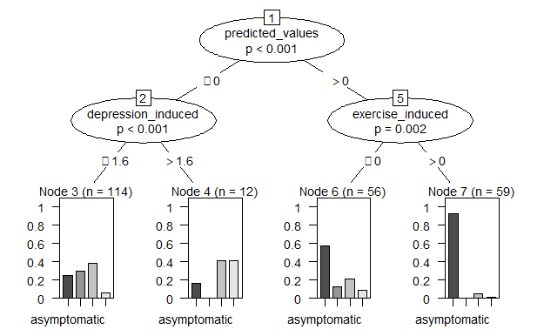
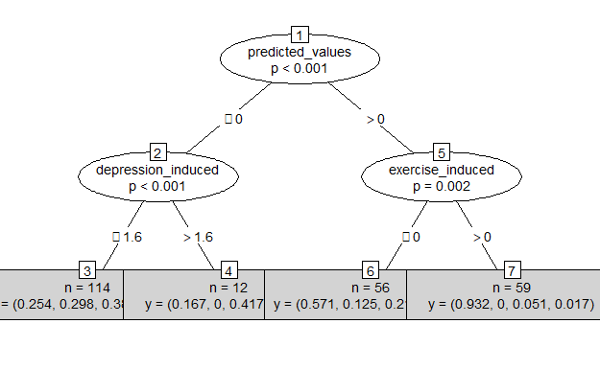
Classification Steps for The Decision Tree
Step 3
VISUALIZATION OF DECISION TREE:
Bar Plot Decision Tree
Numerical Decision Tree for clearer view

Slide 9
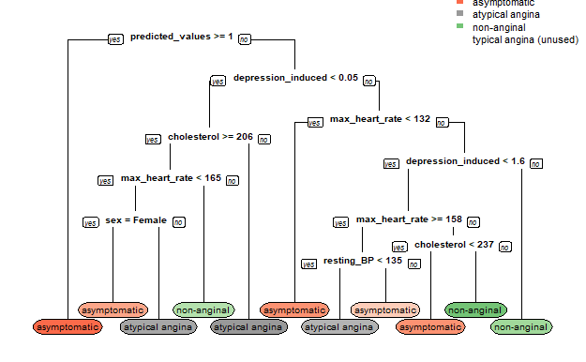
VISUALIZATION OF DECISION TREE: FROM THE RPART PACKAGE
when predicted value is geater or euals to 1,it is depression induced and if the probability of the predicted values is less than 1, the chest pain type is asympomatic and so on.

Slide 10
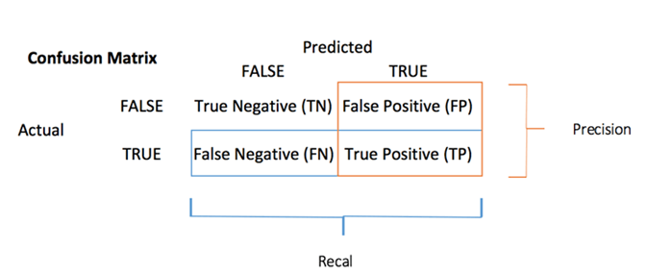

Classification Steps for The Decision Tree
Step 4
PREDICTION:
Prediction of the probability value
Prediction using Confusion matrix
Next slide shows the output of the confusion Matrix for both training and testing set

Slide 11
Result of the Confusion Matrix
Training Data
Testing Data
Actual/Predicted | asymptomatic | atypical angina | non-anginal | typical angina
asymptomatic | 87 | 7 | 15 | 6
atypical angina | 0 | 0 | 0 | 0
non-anginal | 31 | 34 | 49 | 12
typical angina | 0 | 0 | 0 | 0
Actual/Predicted | asymptomatic | atypical angina | non-anginal | typical angina
asymptomatic | 19 | 2 | 3 | 1
atypical angina | 0 | 0 | 0 | 0
non-anginal | 9 | 7 | 17 | 4
typical angina | 0 | 0 | 0 | 0
Misclassification Error = 4.3% Accuracy level = 95.7%
Misclassification Error = 4.2% Accuracy Level = 95.8%

Slide 12
Classification Steps for The Decision Tree
Step 5
I COMPARED THE MODEL PERFOMANCE ON THE TEST SET AFTER TRAINING WITH DIFFERENT CRITERIA The splitting comparison was done using gini based criteria and information based criteria. The prediction accuracy result shows that Gini recorded 0.5967742 while Information Gain recorded 0.5806452. This means that the best splitting model accuracy is Gini based splitting criteria more than the information gain splitting.

Slide 13
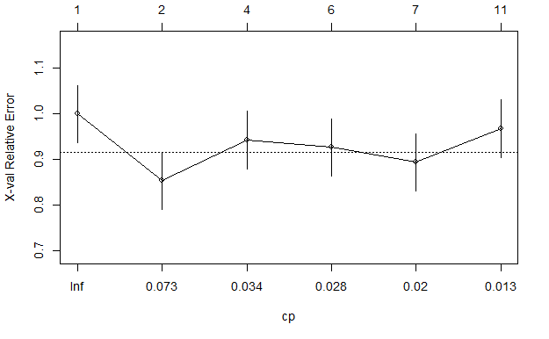
Classification Steps for The Decision Tree
Step 6
CP | Nsplit | Rel error | Xerror | xstd
0.14634146 | 0 | 1.0000000 | 1.0000000 | 0.06309282
0.03658537 | 1 | 0.8536585 | 0.8536585 | 0.06258215
0.03252033 | 3 | 0.7804878 | 0.9430894 | 0.06306238
0.02439024 | 5 | 0.7154472 | 0.9268293 | 0.06301452
0.01626016 | 6 | 0.6910569 | 0.8943089 | 0.06286637
0.01000000 | 10 | 0.6260163 | 0.9674797 | 0.06310151
PRUNNING WITH COMPLEXITY PARAMETER
Complex Parameter Plot
Complex Parameter Table
I decided to prune the decision tree using “complex parameter" to make it easy to interpret and understand

Slide 14
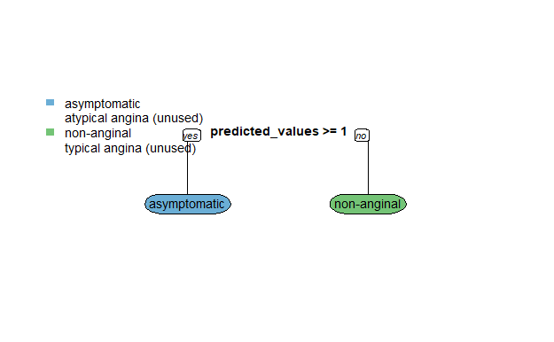
Classification Steps for The Decision Tree
Step 6
OBTAINING AN OPTIMAL PRUNED MODEL
The model accuracy for the pruned Tree shows 0.5806452

Slide 15
The only challenge I had was decided whether to prune it or not. The first decision tree was interpretable to me but for the sake of non technical people, the easier it’s understandable, the better for everyone.
CHALLENGES
Heart diseases are dangerous. Everybody should always have a regular check of their hearts, apply all the necessary measures to stay healthy. Measures such as:
Exercise.
Stop use of tobacco products.
Eat healthy foods.
Keep your stress under control.
Stay at a healthy weight.
If you have medical problems that can increase your risk of a heart attack, taking care of those problems can help prevent a heart attack.
These medical problems include:
High blood pressure.
Chronic kidney diseases
High cholesterol.
Diabetes.
SUGGESTION

Slide 16
CONCLUSION
Nearly half of all heart attacks have no symptoms at all — but that doesn’t mean they’re any less deadly than heart attacks with symptoms.
They are described as “silent” because when they occur, their symptoms lack the intensity of a classic heart attack, such as extreme chest pain and pressure; stabbing pain in the arm, neck, or jaw; sudden shortness of breath; sweating, and dizziness. (Harvard)
People who have a silent heart attack might later recall that they had indigestion, the flu, or a strained chest muscle. But a silent heart attack, like any heart attack, involves blockage of blood flow to your heart and possible damage to the heart muscle. (Medical News, 2019)
From the final analysis, it is predicted that Asymptomatic chest pain is the most killer disease of all chest pain

Slide 17
THANK YOU

